Slide 1

IS 253 OBJECT ORIENTED PROGRAMMING

Slide 2
OBJECTIVES
Understanding the basics of Object Oriented Design and Analysis.
Understanding what is Unified Modelling Language and Its relevance to Object Oriented Programming.
Writing code as part of Implementation of Object Models Designed.
Notes:
Examples of Models include:

Slide 3
INTRODUCTION
In order to write a program we need to understand our problem(Analysis), plan our solution (Design) and build it (Programming).
Before we start building our programs it is imperative we understand the basics of Object Oriented System Analysis and Design Process.
Notes:
Examples of Models include:

Slide 4
Unified Modeling Language (UML)
Unified Modeling Language (UML) is a standardized general-purpose modeling language in the field of object-oriented software engineering for communicating software design.
(UML) is a standardized modeling language enabling developers to specify, visualize, construct and document artifacts of a software system.
UML IS NOT:
a programming language per se.
a software modeling tool.
a method, methodology or software development process .
UML IS:
De facto standard for OO modeling.
Unified modeling language.
UML provides extension mechanisms.

Slide 5
UML Overview
UML constitutes of several diagrams which can be used to model the structure, behaviour and interactions among components of a software system. Commonly used diagrams include:
Use case diagrams - which are used to describe the functional behaviour of the system as seen by the user.
Class diagrams - which are used to describe the static structure of the system: objects, attributes, associations.
Sequence diagrams - which are used to describe the dynamic behaviour between objects of the system.
Activity diagrams - which are used to describe the dynamic behaviour of a system, in particular the workflow.
N.B: Refer to the UML spec https://www.uml.com

Slide 6
UML Overview (Use Cases)
A use case illustrates a unit of functionality provided by the system.
Essentially a use case needs to have the following 3 things:
Title- what is the goal ? (use a Short Phrase, Active Verb ) e.g. Register new member, Transfer funds, Purchase items , Create new page
Actor - who desires it ? (Any external entity that interacts with our system should be identified as an actor) e.g. User, Customer, Member, Administrator, Registration System
Scenario - how is it accomplished ? (This can be written as a single paragraph or a series of steps)
A use case should be short and succinct so that it can be understood by a user of an application.
A use case describes a goal from a perspective of a user, it is not a pseudo code.
Notes:
An actor- anything with a behaviour that leaves outside your software system but has a goal that wants to accomplish through your system.
To identify an actor ask yourself things like:
Are there any External Systems/Organizations.
Do you need to distinguish Roles / Security Groups.
Do you need to distinguish users by Job Titles / Departments.

Slide 7
UML Overview (Use Cases)
Example of a full Use Case is illustrated below:
Title: Purchase items
Actor: Customer
Scenario: Customer reviews items in shopping cart. Customer provides payment and shipping information. System validates payment information and responds with confirmation of order and provides order number that Customer can use to check on order status. System will send Customer a confirmation of order details and tracking number in an email.
A use case describes a goal from a perspective of a user, it is not a pseudocode.
Notes:
You may add Extensions to a use case e.g.
Extensions: Describe steps for out-of-stock-situations
Extensions: Describe steps for order never finalized.
Precondition what must be fullfiled for the use case to be valid.
Postcondition,
Stakeholders
Scope
Level
Etc.

Slide 8
UML Overview (Use Cases)
Example of a full Use Case is illustrated below:
Title: Purchase items
Actor: Customer
Scenario: Customer reviews items in shopping cart. Customer provides payment and shipping information. System validates payment information and responds with confirmation of order and provides order number that Customer can use to check on order status. System will send Customer a confirmation of order details and tracking number in an email.
A use case describes a goal from a perspective of a user, it is not a pseudocode.
Notes:
You may add Extensions to a use case e.g.
Extensions: Describe steps for out-of-stock-situations
Extensions: Describe steps for order never finalized.
Precondition what must be fullfiled for the use case to be valid.
Postcondition,
Stakeholders
Scope
Level
Etc.

Slide 9
UML Overview (Use Case Diagrams)
Use-case diagrams generally show groups of use cases - either all use cases for the complete system, or a breakout of a particular group of use cases with related functionality.
The main purpose of the use-case diagram is to help development teams visualize the functional requirements of a system.
This includes the relationship of "actors" (human beings who will interact with the system) to essential processes, as well as the relationships among different use cases.

Slide 10
UML Overview (Use Case Diagrams)
Suppose we have been tasked to build a basic blogging website and we have identified the following use case titles. [Search Articles, View Article, Manage Users, Create Article]
Suppose our actors are all role based. i.e. [Visitor, Contributor, Administrator ]

Slide 11
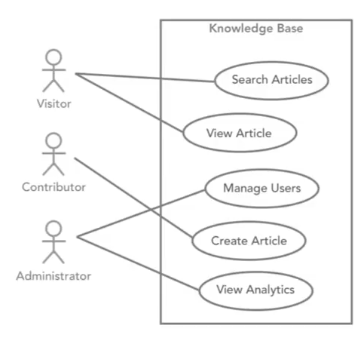
UML Overview (Use Case Diagrams)
A simple use case diagram would look like this:

Slide 12
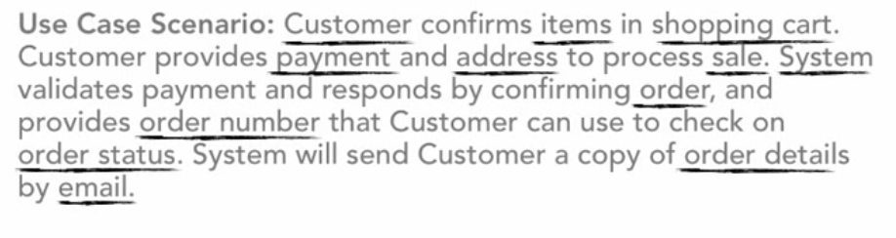
Creating a Conceptual Model
A conceptual model is a representation of a system that uses concepts and ideas to form said representation.
It is quite useful to casually go through use case scenarios and identify nouns used.

Slide 13
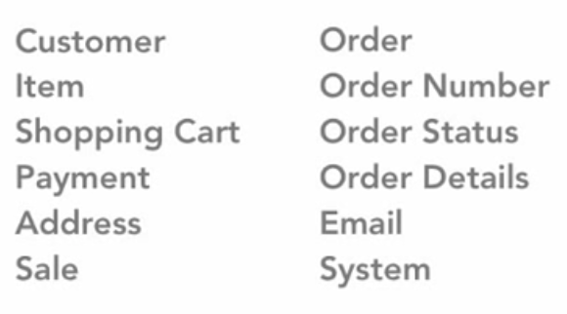
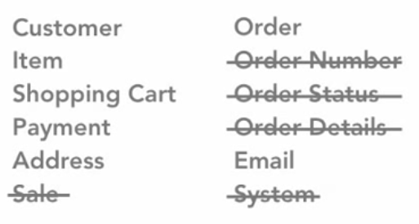
Creating a Conceptual Model
List all of the identified nouns and remove any duplicates, possible attributes will also be identified at this stage and removed

Slide 14
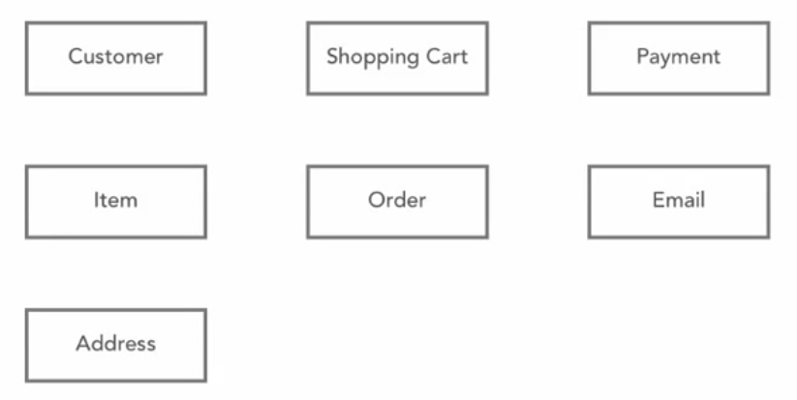
Creating a Conceptual Model
Create a starting point for the diagram of your model as you identify relationships between your identified objects.

Slide 15
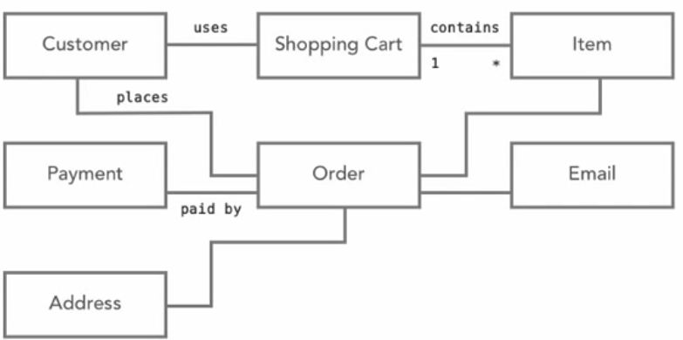
Creating a Conceptual Model
Identify and label the relationships between the objects using explicit verbs as shown below.

Slide 16
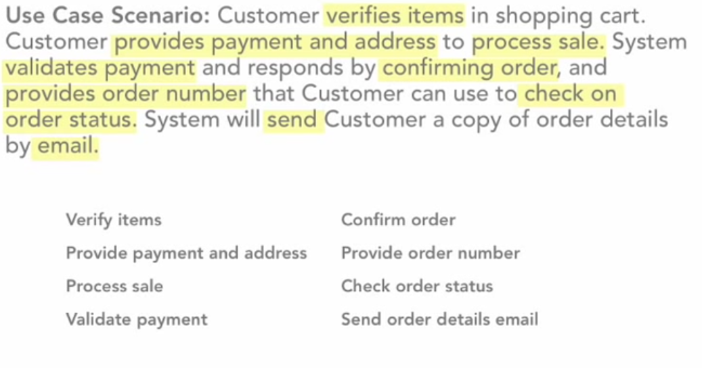
Creating a Conceptual Model
Identify the responsibilities of our conceptual objects , this can be done by identifying verbs/verbs phrases.

Slide 17
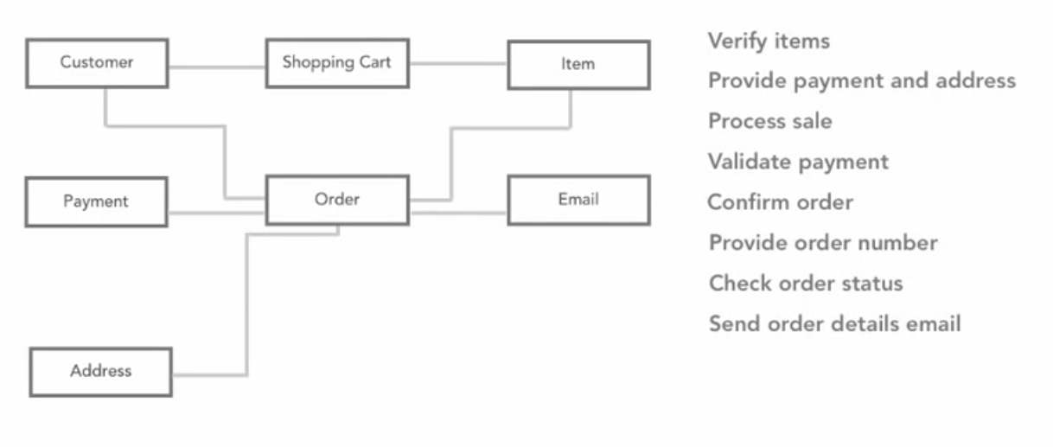
Creating a Conceptual Model
Determining responsibilities of an object can get tricky, one careful concept that should always be followed is that an object should always be responsible for itself.
Notes:
E.g. Its obvious a customer checks the status of an order, but a customer should ask the order object for the status of the order

Slide 18
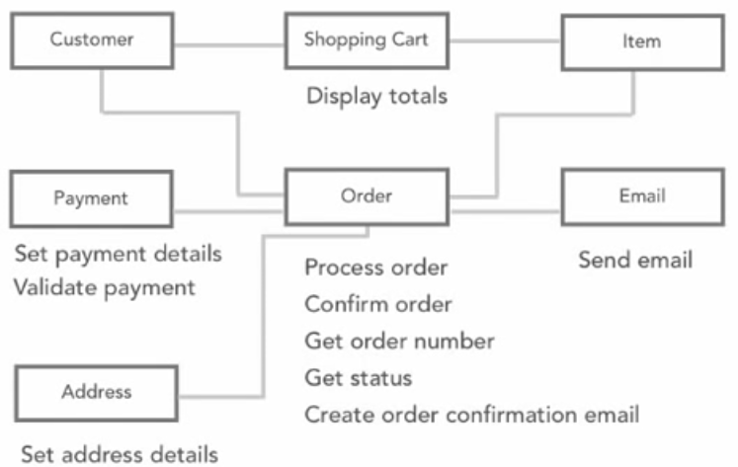
Creating a Conceptual Model
Its quite common to split and rephrase the verbs/verb phrases we identified earlier as we assign them to the respective conceptual objects.
Words such as get and set are commonly used when referring to providing of input data and receiving of information respectively.
Notes:
E.g. Its obvious a customer checks the status of an order, but a customer should ask the order object for the status of the order

Slide 19
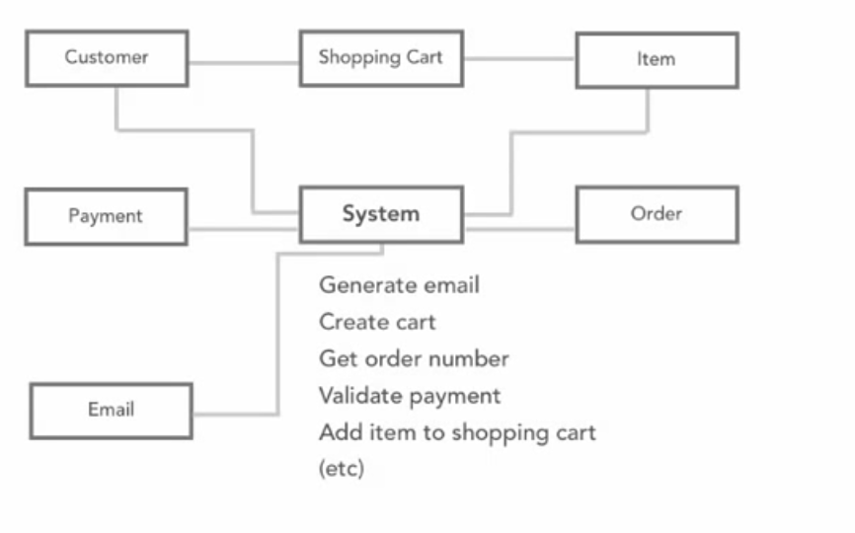
Creating a Conceptual Model
Common mistakes that you need to avoid when creating conceptual model include :
Assigning too much behaviours/responsibilities to an actor simply because it is the object that initiates/drives most of the behaviours/responsibilities.
Creating a general conceptual object called “system” and assigning all identified responsibilities to it , you should rather focus on identifying what part of the system is actually responsible for it.
Responsibilities should always be distributed across your objects.

Slide 20
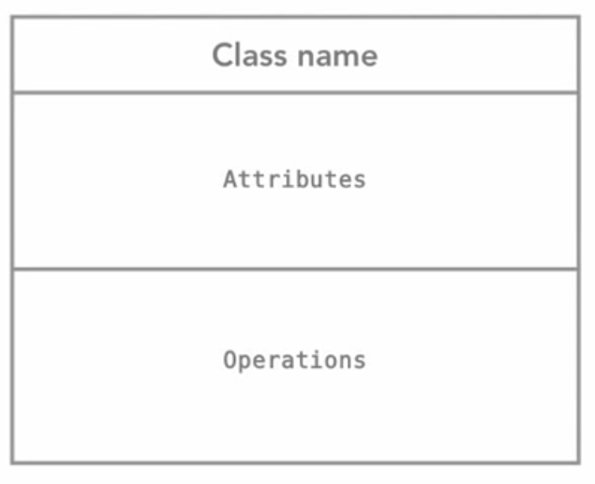
Class Diagram
The information from a conceptual object model can be used to create “Class Diagrams”.
Class Diagrams describes the structure of a system by showing the system’s classes, their attributes, and the relationships among the classes.

Slide 21
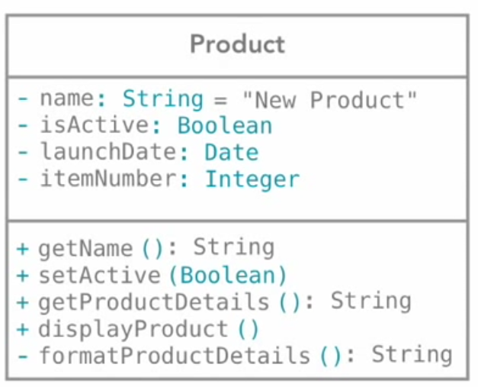
Class Diagram
Example of a class Diagram for “Product”
Default data type
The minus sign indicates visibility
of these attributes being “Private”
Data type of the attribute
Parameter of the method
The plus sign indicates the visibility of these behaviours being
“Public”
Return data type of a method

Slide 22
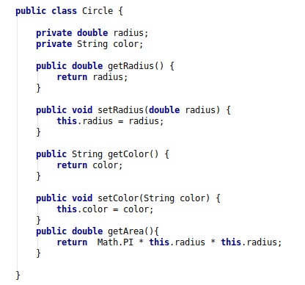
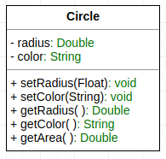
Converting a Class to Code

Slide 23
Class Definition in Java
In Java, we use the keyword class to define a class. For example:
The Syntax for class definition in Java is
[AccessControlModifier] class ClassName {
// Class body contains members (variables and methods)
}
We shall explain the access control modifier, such as public and private, later.

Slide 24
Class Definition in Java
You should always observe the following class naming convention:
A class name shall be a noun or a noun phrase made up of several words.
All the words shall be initially-capitalized (camel-case).
Use a singular noun for class name.
Choose a meaningful and self-descriptive classname. e.g., SoccerPlayer, DatabaseServer, FileInputStream, and PrintStream.

Slide 25
Class Definition in Java
A Java class uses variables to define data fields and methods to define actions.
Additionally, a class provides methods of a special type, known as constructors, which are invoked to create a new object.
A constructor can perform any action, but constructors are designed to perform initializing actions, such as initializing the data fields of objects

Slide 26
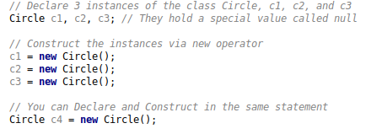
Creating instances of a Class
To create an instance of a class, you have to:
1. Declare an instance identifier (instance name) of a particular class.
2. Construct the instance (i.e., allocate storage for the instance and initialize the instance) using the "new" operator.
For examples, suppose that we have a class called Circle, we can create instances of Circle as follows:
When an instance is declared but not constructed, it holds a special value called null.

Slide 27
Dot (.) Operator
The variables and methods belonging to a class are formally called member variables and member methods.
To reference a member variable or method, you must:
First identify the instance you are interested in.
Use the dot operator (.) to reference the desired member variable or method.
For example, suppose that we have a class called Circle, with two member variables (radius and color) and two member methods (getRadius() and getArea()).
We have created three instances of the class Circle, namely, c1, c2 and c3.
To invoke the method getArea(), you must first identify the instance of interest, says c2, then use the dot operator, in the form of c2.getArea().

Slide 28
Dot (.) Operator
Calling getArea() without identifying the instance is meaningless, as the radius is unknown (there could be many instances of Circle - each maintaining its own radius).
Furthermore, c1.getArea() and c2.getArea() are likely to produce different results.
In general, suppose there is a class called AClass with a member variable called aVariable and a member method called aMethod().
An instance called anInstance is constructed for AClass. You use anInstance.aVariable and anInstance.aMethod().

Slide 29
Member Variables
A member variable has a name (or identifier) and a type; and holds a value of that particular type
Variable Naming Convention:
A variable name shall be a noun or a noun phrase made up of several words.
The first word is in lowercase and the rest of the words are intiial-capitalized (camel-case), e.g., fontSize, roomNumber, xMax, yMin and xTopLeft.
The formal syntax for variable definition in Java is:
[AccessControlModifier] type variableName = [initialValue];
For example:
private double radius = 22.70;

Slide 30
Member Methods
Receives arguments from the caller.
Performs the operations defined in the method body.
Returns a piece of result (or void) to the caller.
The syntax for method declaration in Java is as follows:
[AccessControlModifier] returnType methodName ([parameterList]) {
// method body or implementation ......
}
For example:
// Return the area of this Circle instance
public double getArea() {
return radius * radius * Math.PI;
}

Slide 31
Member Methods
Method Naming Convention:
A method name shall be a verb, or a verb phrase made up of several words.
The first word is in lowercase and the rest of the words are initial-capitalized (camel-case).
For example, getArea(), setRadius(), getParameterValues(), hasNext().

Slide 32
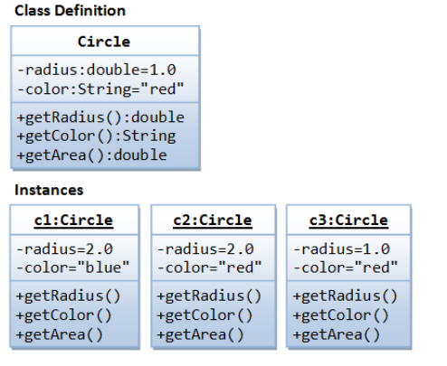
Example of An Implementation

Slide 33
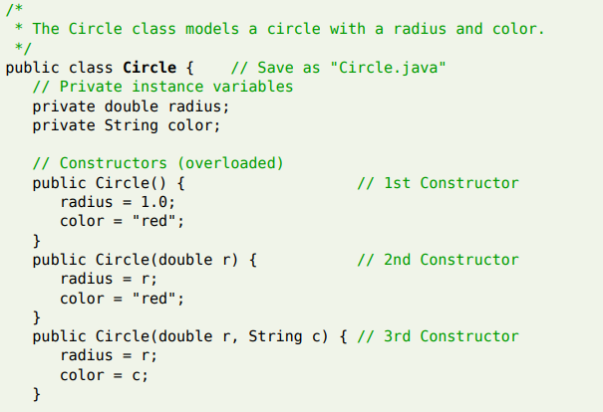
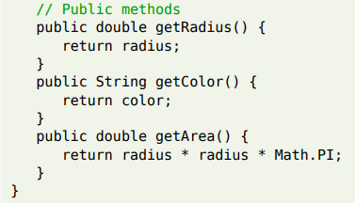
Putting it all together

Slide 34
Putting it all together
Notice that the Circle class does not have a main() method.
Hence, it is NOT a standalone program and you cannot run the Circle class by itself.
The Circle class is meant to be a building block - to be used in other programs.
We shall now write another class called TestCircle, which uses the Circle class.
The TestCircle class has a main() method and can be executed.

Slide 35
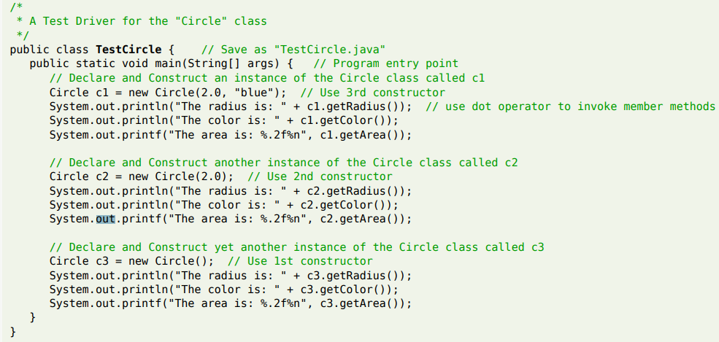
Putting it all together

Slide 36
Constructors
A constructor looks like a special method that has the same method name as the class name.
In the previous Circle class, we define three overloaded versions of constructor Circle(......).
A constructor is used to construct and initialize all the member variables.
To construct a new instance of a class, you need to use a special "new" operator followed by a call to one of the constructors. For example:
Circle c1 = new Circle();
Circle c2 = new Circle(2.0);
Circle c3 = new Circle(3.0, "red");

Slide 37
Constructors
A constructor is different from an ordinary method in the following aspects:
The name of the constructor method is the same as the class name.
By class name's convention, it begins with an uppercase (instead of lowercase for ordinary methods).
Constructor has no return type.
It implicitly returns void.
No return statement is allowed inside the constructor's body.
Constructor can only be invoked via the "new" operator.
It can only be used once to initialize the instance constructed.
Once an instance is constructed, you cannot call the constructor anymore.
Constructors are not inherited (to be explained later).

Slide 38
Constructors
Default Constructor: A constructor with no parameter is called the default constructor.
It initializes the member variables to their default value.
For example, the Circle() in the previous example initialized member variables radius and color to their default value.

Slide 39
Method Overloading
Method overloading means that the same method name can have different implementations (versions).
However, the different implementations must be distinguishable by their parameter list (either the number of parameters, or the type of parameters, or their order).
Overloading methods enables you to define the methods with the same name as long as their signatures are different.
Consider the following example:

Slide 40
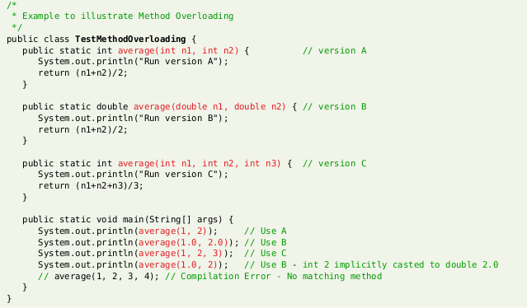
Method Overloading

Slide 41
Method Overloading
Constructor, like an ordinary method, can also be overloaded.
Recall, the previous example of the Circle class we had the following constructors:
Circle()
Circle(double r)
Circle(double r, String c)
Depending on the actual argument list used when invoking the method, the matching constructor will be invoked.
If your argument list does not match any one of the methods, you will get a compilation error.

Slide 42
Visibility Modifiers
Visibility modifiers can be used to specify the visibility of a class and its members.
You can use the public visibility modifier for classes, methods, and data fields to denote that they can be accessed from any other classes.
If no visibility modifier is used, then by default the classes, methods, and data fields are accessible by any class in the same package.
This is known as package-private or package-access.
Packages can be used to organize classes. To do so, you need to add the following line as the first non comment and nonblank statement in the program:
package packageName;

Slide 43
Visibility Modifiers
Visibility modifiers can be used to specify the visibility of a class and its members.
The public visibility modifier can be used to denote that classes, methods, and data fields to denote can be accessed from any other classes.
If no visibility modifier is used, then by default the classes, methods, and data fields are accessible by any class in the same package.
This is known as package-private or package-access.
Packages can be used to organize classes. To do so, you need to add the following line as the first non comment and nonblank statement in the program:
package packageName;

Slide 44
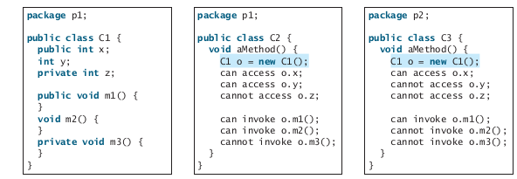
Visibility Modifiers
In addition to the public and default visibility modifiers, Java provides the private and protected modifiers for class members.
The private modifier makes methods and data fields accessible only from within its own class.
The private modifier restricts access to its defining class, the default modifier restricts access to a package, and the public modifier enables unrestricted access.

Slide 45
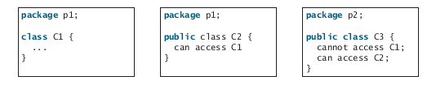
Visibility Modifiers
If a class is not defined as public, it can be accessed only within the same package as shown below:
A nonpublic class has package-access.

Slide 46
Visibility Modifiers
If a class is not defined as public, it can be accessed only within the same package as shown below:
A nonpublic class has package-access.

Slide 47
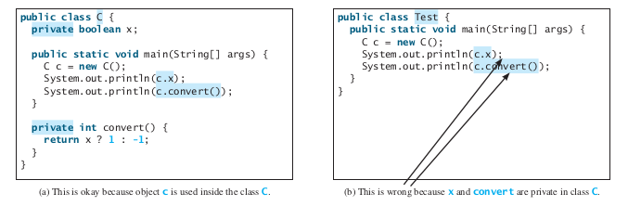
Visibility Modifiers
A visibility modifier specifies how data fields and methods in a class can be accessed from outside the class.
There is no restriction on accessing data fields and methods from inside the class.

Slide 48
Visibility Modifiers
The private modifier applies only to the members of a class.
The public modifier can apply to a class or members of a class.
Using the modifiers public and private on local variables would cause a compile error.

Slide 49
Visibility Modifiers (In Summary)
An access control modifier can be used to control the visibility of a class, or a member variable or a member method within a class.
public: The class/variable/method is accessible and available to all the other objects in the system.
private: The class/variable/method is accessible and available within this class only.

Slide 50
Discussion
Can a constructor have a private access modifier ? Provide reasons to support your answer

Slide 51
Encapsulation
A class encapsulates the name, static attributes and dynamic behaviors into a "3-compartment box".
Once a class is defined, you can seal up the "box" and put the "box" on the shelve for others to use and reuse.
Anyone can pick up the "box" and use it in their application. This cannot be done in the traditional procedural-oriented language like C, as the static attributes (or variables) are scattered over the entire program and header files.
You cannot "cut" out a portion of a C program, plug into another program and expect the program to run without extensive changes.
Member variables of a class are typically hidden from the outside word (i.e., the other classes), with private access control modifier.
Access to the member variables are provided via public assessor methods, e.g., getRadius() and getColor().
This follows the principle of information hiding. i.e. objects communicate with each others using well-defined interfaces (public methods)

Slide 52
Encapsulation
Objects are not allowed to know the implementation on details of others.
The implementation details are hidden or encapsulated within the class.
Information hiding facilitates reuse of the class.
Rule of Thumb: Do not make any variable public, unless you have a good reason.

Slide 53
Encapsulation
To prevent direct modifications of data fields, you should declare the data fields private, using the private modifier.
This is known as data field encapsulation.
A private data field cannot be accessed by an object from outside the class that defines the private field.
However, a client often needs to retrieve and modify a data fields.
To make a private data field accessible, provide a getter method to return its value.
To enable a private data field to be updated, provide a setter method to set a new value.
A getter method is also referred to as an accessor and a setter to a mutator.

Slide 54
Encapsulation
A getter method has the following signature:
public returnType getPropertyName()
If the returnType is boolean , the getter method should be defined as follows by convention:
boolean accessor
public boolean isPropertyName()
A setter method has the following signature:
public void setPropertyName(dataType propertyValue)

Slide 55
Encapsulation
A getter method has the following signature:
public returnType getPropertyName()
If the returnType is boolean , the getter method should be defined as follows by convention:
boolean accessor
public boolean isPropertyName()
A setter method has the following signature:
public void setPropertyName(dataType propertyValue)

